Slide 1
Hiring Process Analytics

Slide 2
Contents
Hiring Analysis
Salary Analysis
Salary Distribution
Departmental Analysis
Position Tier Analysis

Slide 3
Project description
In hiring process analytics, statistics used to analysis to evaluate and enhance the hiring process, focusing on identifying trends, biases, and key performance indicators to optimize candidate selection and overall hiring efficiency.
Approach
With the provided dataset I clean and analyze hiring data using statistical methods, such as regression analysis and hypothesis testing, to uncover patterns and insights, and provide actionable recommendations for improving the recruitment strategy with the help of excel.

Slide 4
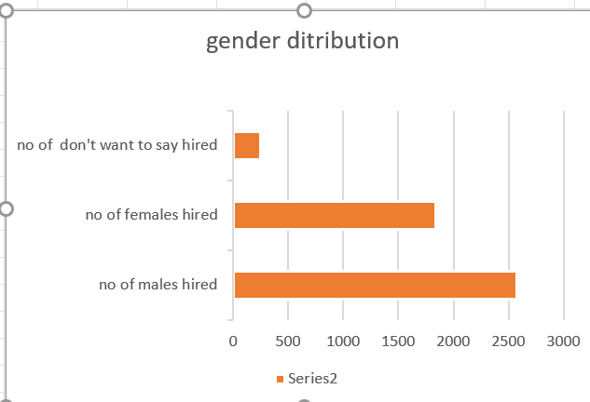

Hiring Analysis

Slide 5

Salary Analysis

Slide 6
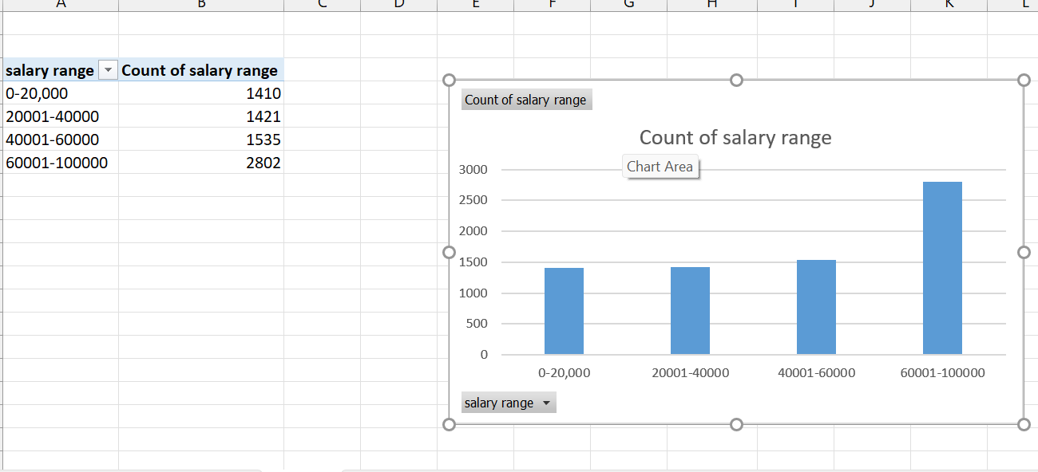
Salary Distribution

Slide 7
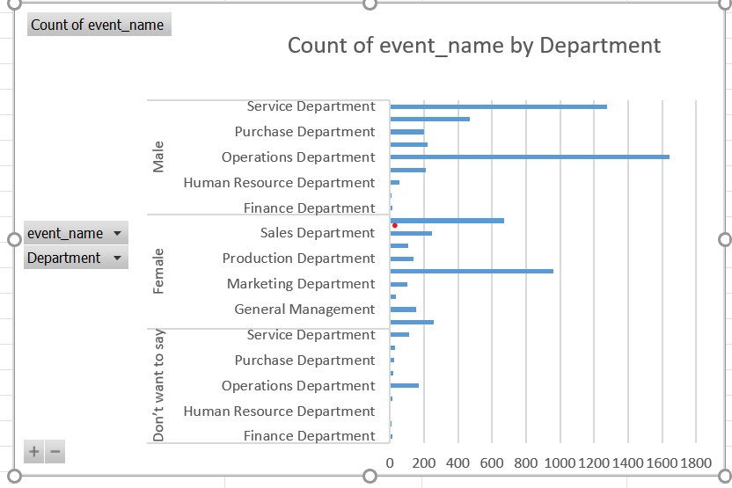
Departmental Analysis

Slide 8
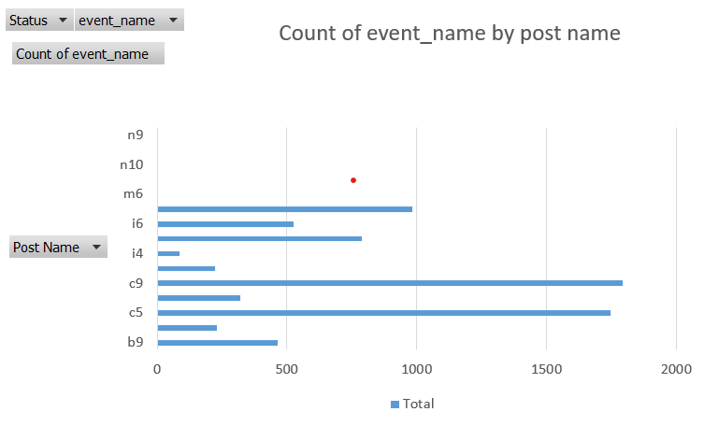
Position Tier Analysis

Slide 9
Tech-Stack used
I used Microsoft excel 2021 for the hiring process analytics project
Insights and Results
Through this project, I gained valuable skills in statistics and Excel. I learned how to use statistical methods like regression analysis and hypothesis testing to analyze data and identify trends and biases. These helps draw meaningful insights and make data-driven decisions to improve the hiring process.

Slide 10
Hyperlink of statistics excel
https://docs.google.com/spreadsheets/d/1V72Ik4YGxGmeekxBoQlS0WpuAkMEJRH-/edit?usp=sharing&ouid=114293071387875296860&rtpof=true&sd=true

